Slide 1

WEB REQUEST LIFE CYCLE
Tenacious

Slide 2
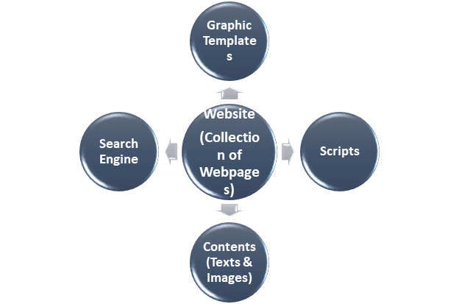
Website
Website is a collection of webpages which contains numerous types of information in the form of graphics templates, scripts, and contents (texts & images). These web pages usually reside on a web server which is connected to the internet. Web Server is a computer which is used to store, process, and deliver webpages to the clients. Web Server is specially used to host the websites by Web Hosting Provider Company.

Slide 3
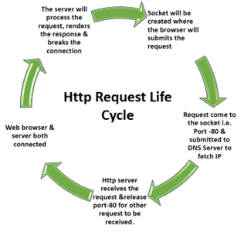
HTTP LIFE CYCLE

Slide 4
HTTP LIFE CYCLE
Web Browser submits the request to the server after creating a socket in local progress.
The http server waits for the request to come on socket i.e. port-80.
The web browser translates the yahoo.com to an IP address if it does not knows it.
If the web browser does not recognize the address it contacts a DNS Server to resolve the name.
The browser will open a TCP connection to the IP address of yahoo.com and send a HTTP GET request over.
The request is then submitted to DNS server where IP address is fetched based on domain name.
Now the request is submitted to Http Server as per HTTP protocol.
Http server receives the request and shifts the client to another socket.
So the socket on port-80 is released to receive request from other clients.
Web Browser & server both are connected to each other.
The server will process the request, renders the response & breaks the connection.
Notes:
This slide is only for the trainer… You can display the poll from GTM and after the poll is taken, share the result, connect the poll result with the topic. Once done, you can hide the poll so that the PPT is visible.
I have created the poll in the GTM webinar.

Slide 5
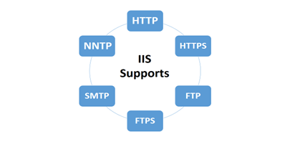
IIS
IIS stands for Internet Information Services. Formerly known as Internet Information Server, IIS is a Web Server or a Windows component that accepts requests from Client browser and responds with the requested page(s). It is an extensible web server that supports HTTP, HTTPS, FTP, FTPS, SMTP, & NNTP protocols.

Slide 6


